Slide 1
Brakes and Clutches
ME 313: Mechanical Design
Week 12

Slide 2
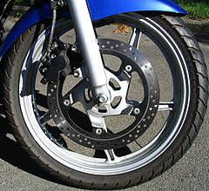
Topics
Types of brakes and clutches
Actuation force required
Torque capacity
Operating time

Slide 3
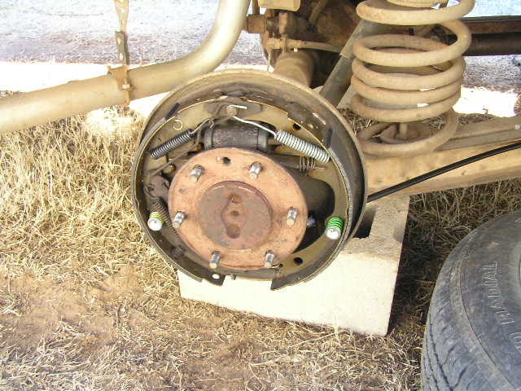
Types of Clutches and Brakes
Band Brake
Frictional Contact
Disk Brake
Cone Brake

Slide 4
Band Brake: Overview
Much like belt and pulley, band brake use friction to apply negative torque
D
θ
F₁
F₂

Slide 5
Band Brake
Similar in principles to band and pulley power transmission
Torque capacity

Slide 6
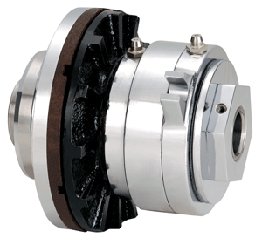
Frictional Contact Axial Clutches and Brakes: Overview
Axial force translate directly to normal force and friction
Friction allows transfer of torque

Slide 7
Frictional Contact Axial Clutches and Brakes Calculation
Assuming uniform pressure
Torque capacity

Slide 8
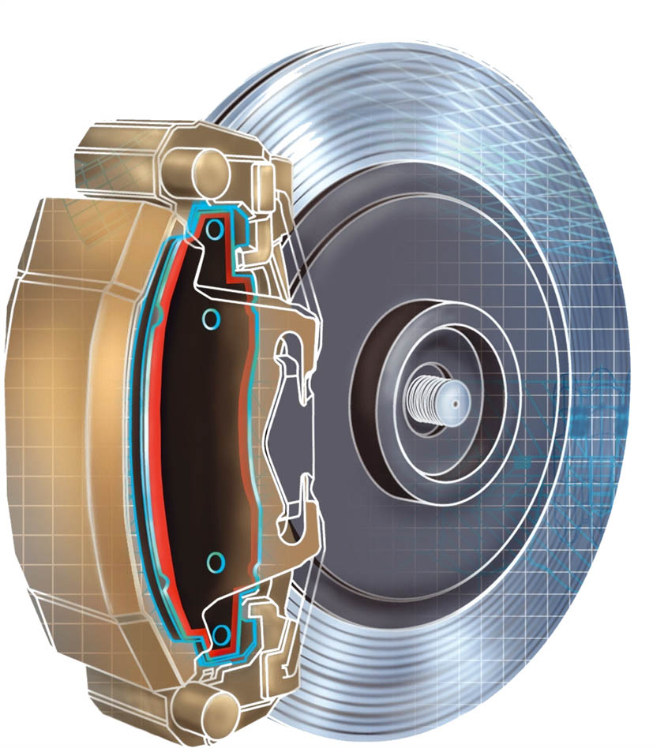
Disk Brakes: Overview
Similar in principle to frictional contact axial clutches or brakes

Slide 9
Disk Brake
Assuming uniform pressure
Torque capacity

Slide 10
Cone Clutches and Brakes: Overview
Due to cone shape, axial force is supported by normal force on the cone surface
Friction between cone and drum can carry torque
F
d
P_{a}
d
α

Slide 11
Cone Clutches and Brake: Force and Torque Calculation
Assuming uniform pressure
Torque capacity

Slide 12
Operating Time
We have that
assuming the torque from brake is constant and that a system is rotating at

Slide 13
Conclusion

Slide 14
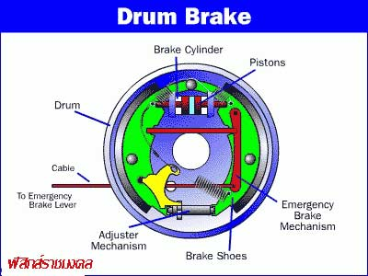
Internal Expanding Rim (Drum Brake)
Used mostly in automotive applications

Slide 15
Moments from Force on Drum
Pressure distribution
Moment from friction
Moment from normal force

Slide 16
Required Actuation Force and Torque Capacity
Actuation force balances out the moment
Torque capacity

